Slide 1
Physics Problem Solving
Mar. 11th Mon 12:40
Physics Lab P2
Dara Daneshvar
Lev Shabalin
Eason Shao

Slide 2
Today
Fun Questions!
& Good luck to everyone taking part in SPC tomorrow

Slide 3
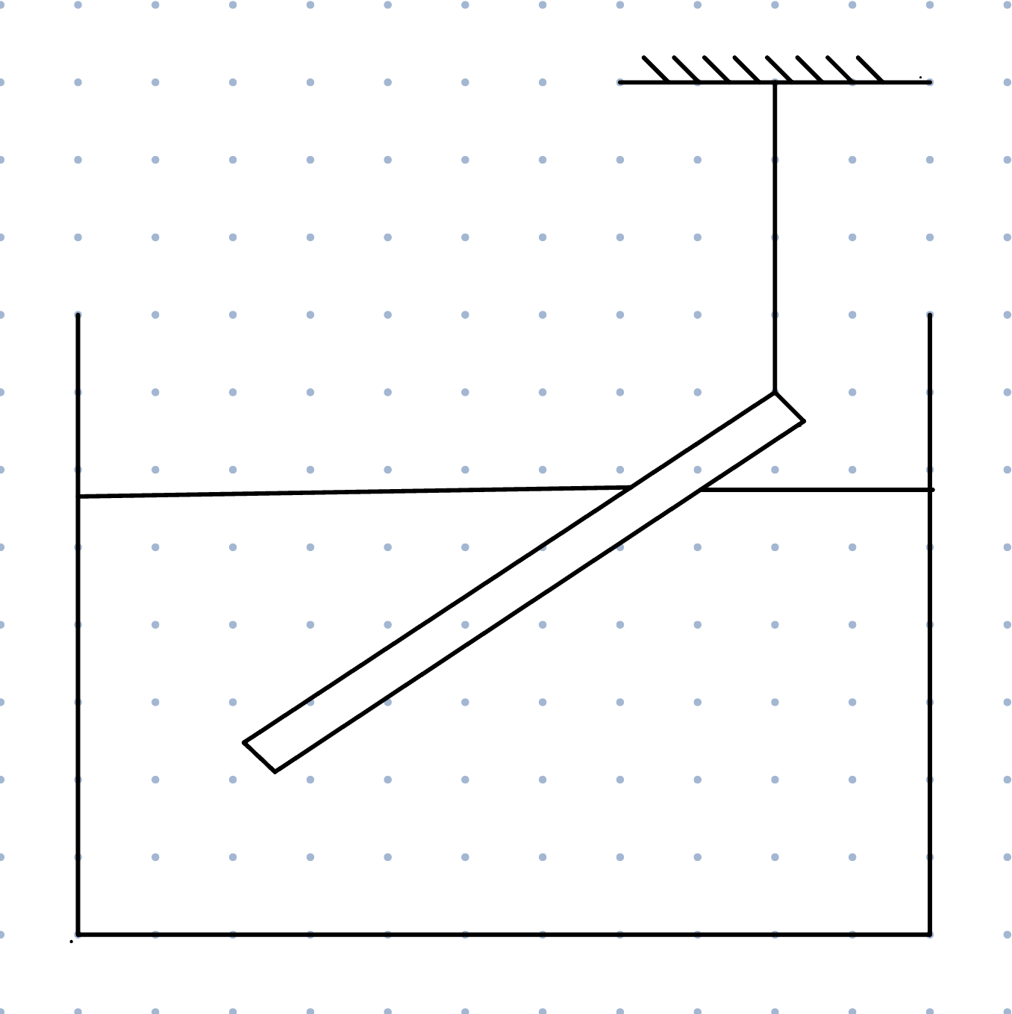
Qu. 1 (Rotational Mechanics)
A stick with length 1 metre is hung using a rope at the top end, and its lower end sticks into a container filled with water. If it has a weight of 15 newtons, and the string has a tension of 5 newtons, what percentage of its length is dry after it's taken out?

Slide 4
Qu. 1
Key Takeaways:
It is non-intuitive why we will think of rotations but when you notice that forces are non-co-linear, rotational equilibrium is always a thing to think about.
Choice of pivot is arbitrary – if it’s not rotating, it’s not rotating around any point, therefore taking moments around any point will give a moment of zero.
Therefore, choose the pivot at which you can get rid of all the forces you hate. (Line of action of force passing through the pivot)
Always draw a force diagram since it is always useful.

Slide 5
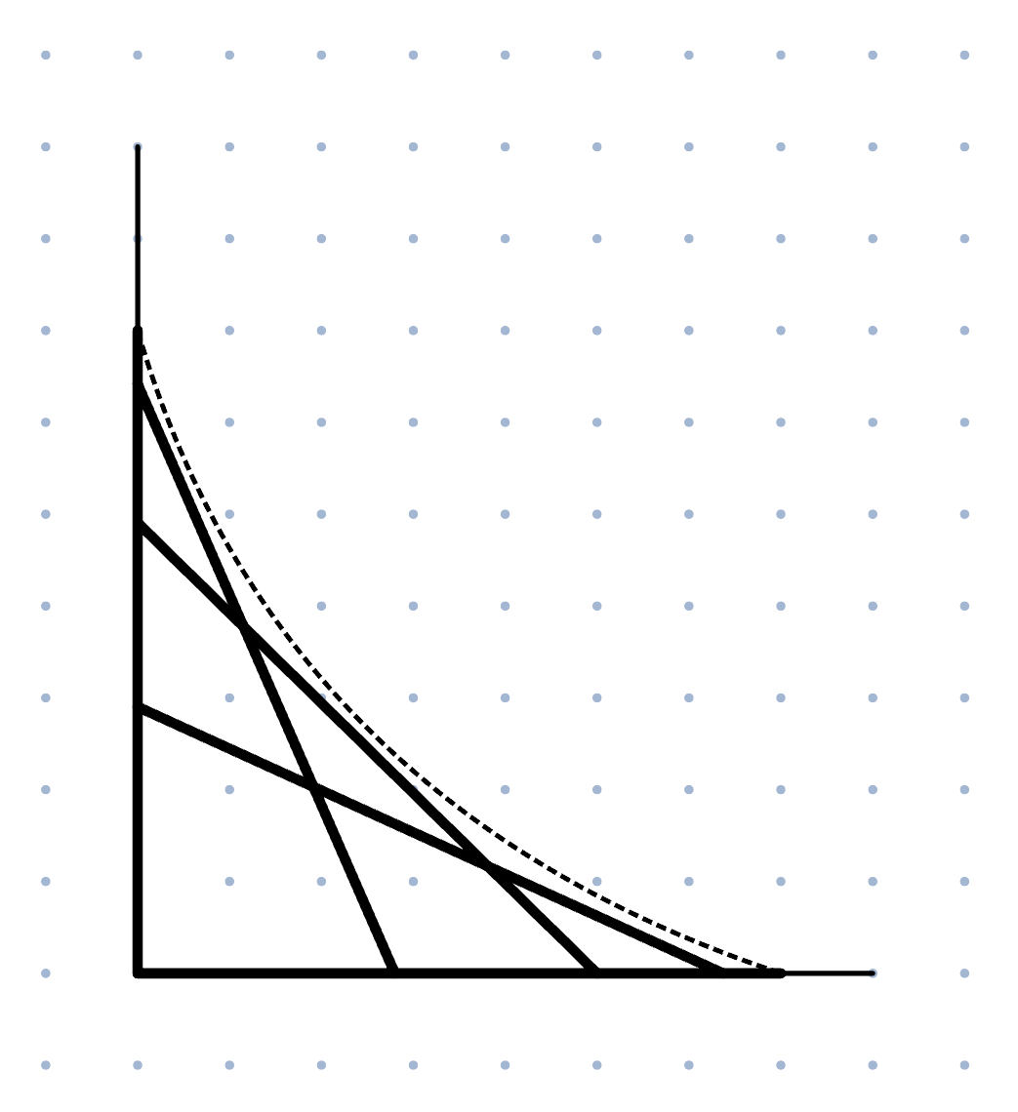
Qu. 2 (Mathematical Methods)
A ladder initially sits against a vertical wall. When it slides down (with its top end touching the wall, and bottom end touching the floor), what is the equation of the envelope formed by the ladder's positions?

Slide 6
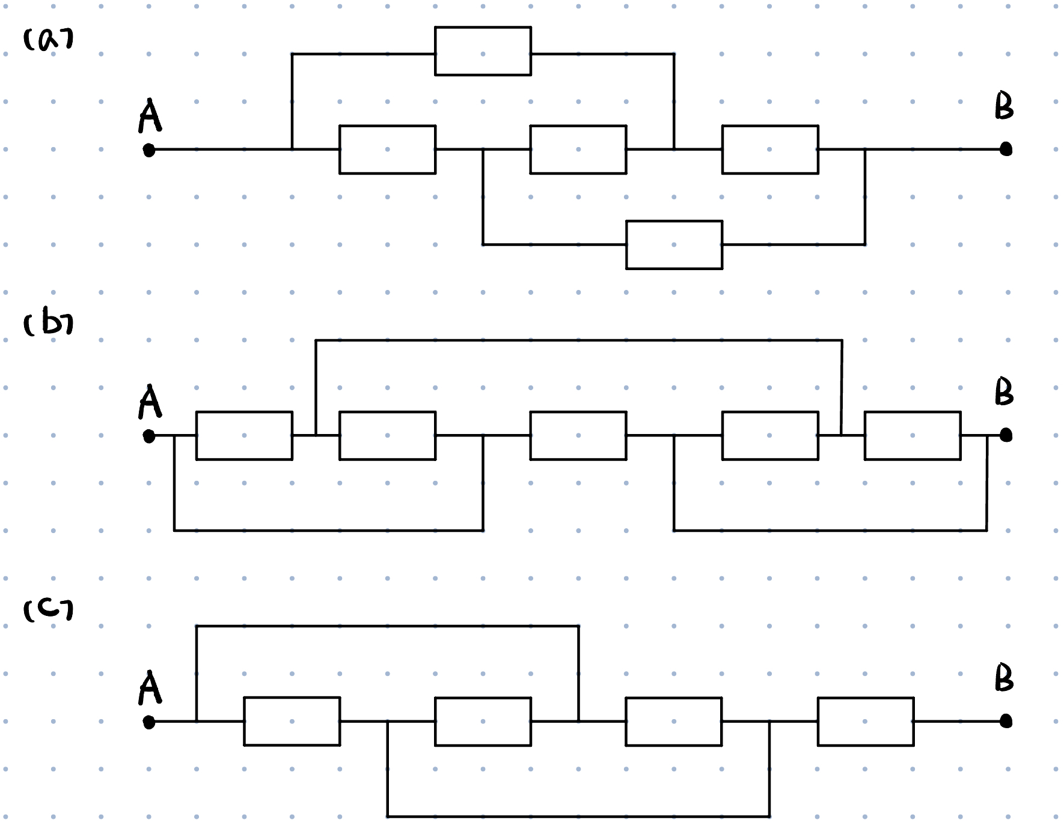
Qu. 3 (Electricity & Circuits)
Find the resistance of AB in the following diagrams. Assume each resistor has a resistance of 1 ohm.

Slide 7
Qu. 3
Key Takeaways
A wire is a resistance-less connection, which doesn’t have a difference compared to a simple shared end (why?)
Colouring techniques work really well in some weird wires connecting between weird nodes)
Squishing & stretching a circuit diagram (to its topological equivalent) or drawing a equivalent diagram can really help solving resistance problems
More resistance questions (& a specific session on circuit analysis techniques) yet to come!

Slide 8
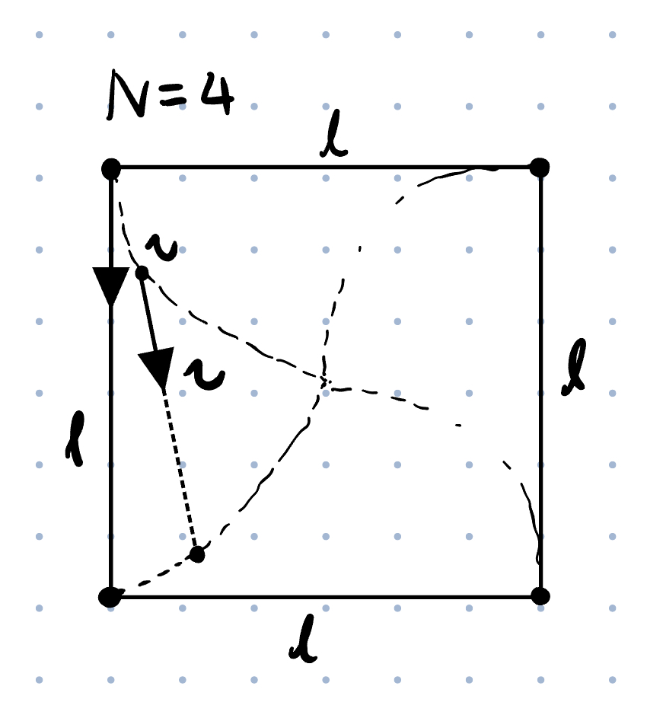
Qu. 4 (Reference Frame)
A bug sits at each corner of a regular polygon with N sides of side length l. Each bug walks directly towards the next bug around, counterclockwise, with a constant speed v. Find the time it takes for the bugs to reach the centre of the polygon. It might help to begin with setting N = 4 and experiment with small cases, and worry about generalising later.

Slide 9
Qu. 4
Key Takeaways
Correct choice of reference frames could make your life easier
Sometimes a generalized model will be very difficult to think to start with
Therefore, a nice idea is to start and experiment with small cases (or setting certain values, to 1 unit for example)

Slide 10
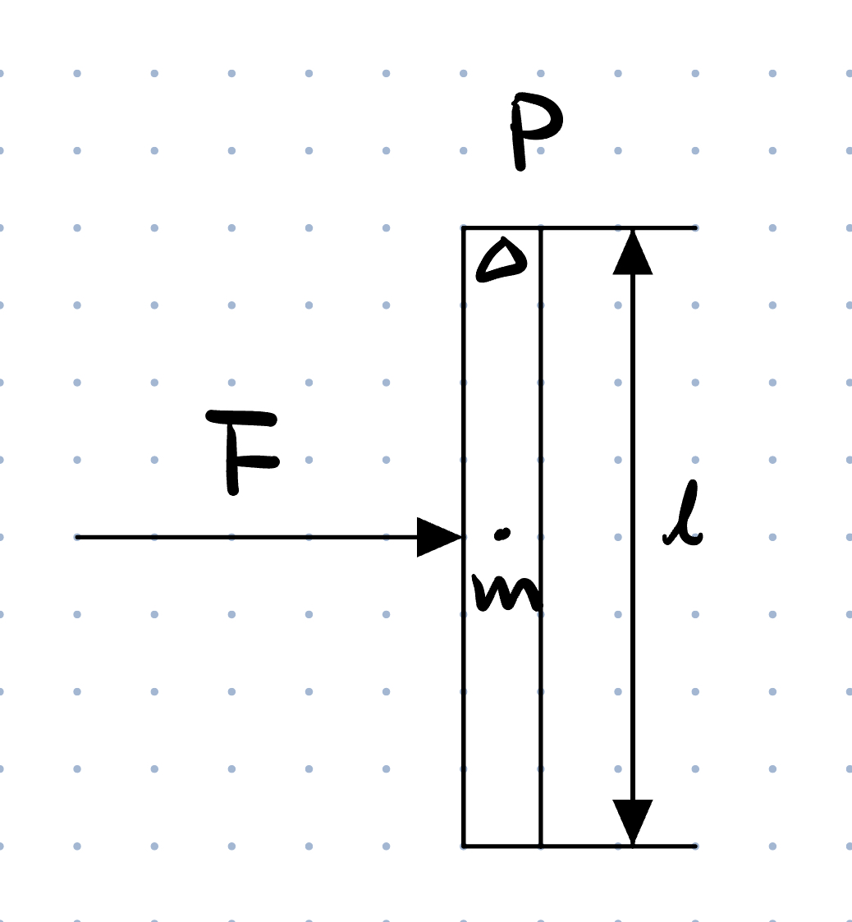
Qu. 5 (Reference Frame, Rotational Mech.)
Imagine if we have a uniform stick of mass m and length l in void space, initially at rest. We apply a force F, perpendicular to the stick, at the centre of the stick. It is not difficult to realise that it accelerates along the line of action of the force, without rotating. However, if we choose one end of the stick to be the pivot, the resultant moment seems to be not zero. Can you explain why?

Slide 11
Qu. 5
Key Takeaways
Be careful about inertial frames and non-inertial frames
D’Almbert’s Principle on Inertial Forces: one can transform an accelerating rigid body into an equivalent static system by adding the so-called inertial force which must act through the centre of mass
Remember that inertial force also contributes moments!
An interesting story (ES)

Slide 12
Sources of Questions
Questions we made (people probably made them before us):
Qu. 1, 2: ES
Qu. 5: LS
Q3: Collection of Solved Problems in Physics (ES)
http://physicstasks.eu/2338/non-traditional-circuits-i
http://physicstasks.eu/2339/non-traditional-circuits-ii
Q4: Issac Physics (DD, LS)
https://isaacphysics.org/questions/love_bugs_num
Diagrams: Originality Claimed (ES)

Slide 13
Some More
Please feel free to continue to submit solutions
We will continue to provide individual feedback on your work for all submitted before Friday 16:15.
Feedback Form & Question Submission form are on Google Classroom.

Slide 14
Next Time
Cool-down session discussing SPC
(And more TBC)
& Good luck to all taking the SPC tomorrow!

